Slide 1



FIREWALL
Jyoti
senselearner

Slide 2
What is a firewall
A firewall is a network security device, either hardware or software-based, which monitors all incoming and outgoing traffic and based on a defined set of security rules it accepts, rejects or drops that specific traffic.

Slide 3
TYPES OF FIREWALL
Packet filtering firewall
Circuit level gateway
Application level gateway
Stateful inspection firewall
Next generation firewall

Slide 4
PACKET FILTERING FIREWALL
A packet filtering firewall is a type of firewall that controls network traffic by examining the headers of incoming and outgoing packets. The firewall uses a set of rules to determine whether to allow or deny a packet. Packet filtering firewalls are the simplest type of firewall, but they can be effective in blocking common attacks.
FEATURES:
Single device filter traffic for the entire network.
Inexpensive
Efficient and fast at processing packets

Slide 5
CIRCUIT- LEVEL GATEWAY
A circuit-level gateway firewall is a type of firewall that operates at the session layer of the OSI model. It provides security for TCP and UDP networks by verifying packets and connection requests on a virtual circuit between two transport layers. Circuit-level gateway firewalls also function as handshaking devices between trusted servers and clients with untrusted hosts.
FEATURES:
They can provide security for both TCP and UDP networks.
They can act as handshaking devices between trusted servers and clients with untrusted hosts.
They are relatively inexpensive to implement.

Slide 6
APPLICATION LEVEL GATEWAY
Application Gateway is a type of firewall that supports application-level control over network traffic. Application gateways can be used to deny access to the resources of private networks to distrusted clients over the web.
An application gateway is an application program that runs on a firewall system between two networks.
FEATURES:
Operates at the application layer of the OSI model
Analyzes the content and behavior of application protocols
Provides granular control over specific application and their functions.

Slide 7
STATEFUL INSPECTION FIREWALL
A stateful inspection firewall (also known as dynamic packet filtering) is a type of firewall that keeps track of the state of network connections. This allows the firewall to allow or deny traffic based on the context of the connection, rather than simply inspecting individual packets.
FEATURES:
Maintains a state table to track a state of network connections
Analyzes packet attributes, including sources /destination IP, port numbers and connections status
Provides protection against certain types of dos attacks

Slide 8
NEXT GENERATION FIREWALL
A next-generation firewall (NGFW) is part of the third generation of firewall technology that can be implemented in hardware or software. It is capable of detecting and blocking sophisticated attacks by enforcing security policies at the application, port and protocol levels.
FEATURES:
Application awareness
Integrated intrusion prevention systems (IPSes)
Identity awareness -- user and group control
Bridged and routed modes
The ability to use external intelligence sources

Slide 9
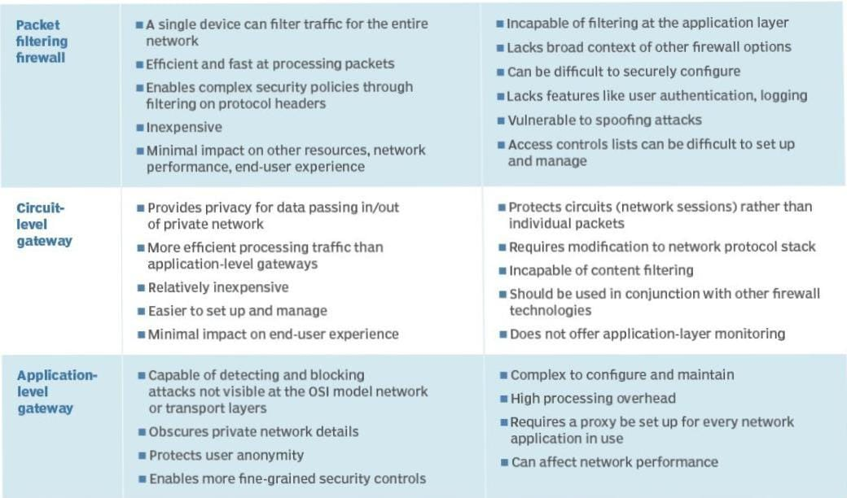
Comparing strengths and weaknesses of firewalls

Slide 10
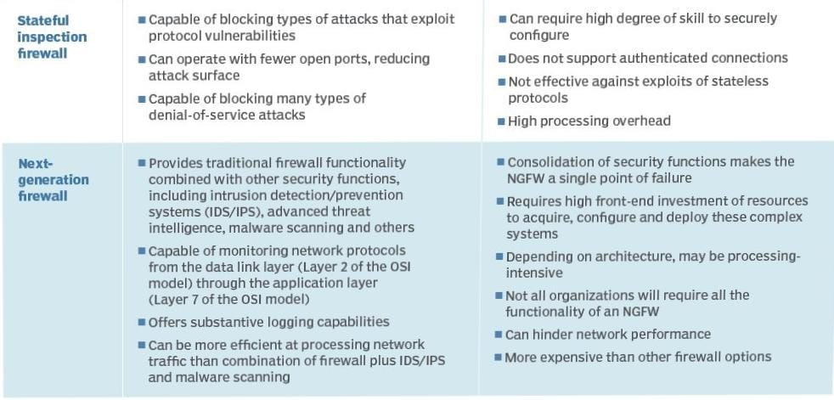
Firewall strengths weaknesses

Slide 11
THANK YOU!

